Slide 1
Basics of
Web Design
PRESENTED BY : Mrs. KAVITA

Slide 2
Learning Outcomes
Describe the evolution of the Internet and the Web
Explain the need for web standards
Describe universal design
Identify benefits of accessible web design
Identify reliable resources of information on the Web
Identify ethical use of the Web
Describe the purpose of web browsers and web servers
Identify Internet protocols
Define URIs and domain names
Describe XHTML and HTML
Create your first web page
Use the body, head, title and meta elements
Name, save, and test a web page

Slide 3
The Evolution of the Internet
Internet
  Interconnected network of computer networks
  ARPAnet
    Advanced Research Project Agency
    1969 – four computers connected
  NSFnet
    National Science Foundation
  Use of the Internet was originally limited to government, research and academic use
  1991 Commercial ban lifted

Slide 4

The World Wide Web
The graphical user interface to information stored on some of the computers connected to the Internet.

Slide 5

Web Standards and the W3C Consortium
W3C – World Wide Web Consortium
  Develops recommendations and prototype technologies related to the Web
  Produces specifications, called Recommendations, in an effort to standardize web technologies

Slide 6
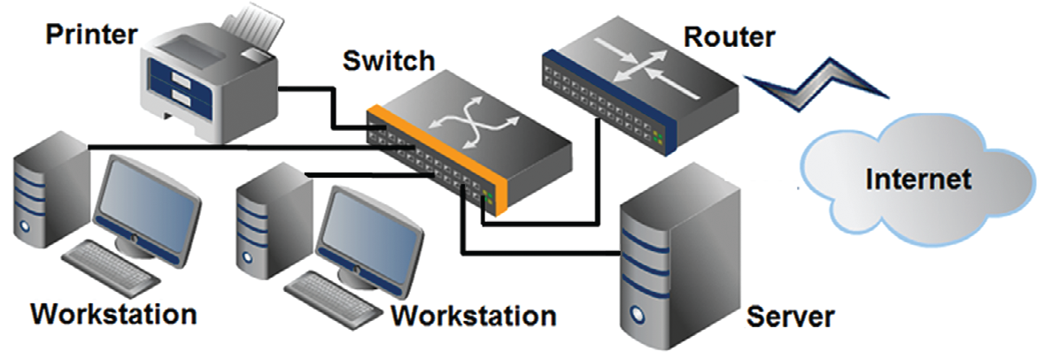
Network Overview
Network
two or more computers connected together for the purpose of communicating and sharing resources

Slide 7
The Client/Server Model
Client/Server can describe a relationship between two computer programs – the "client" and the "server".
Client
  requests some type of service (such as a file or database access) from the server.
Server
  fulfills the request and transmits the results to the client over a network

Slide 8
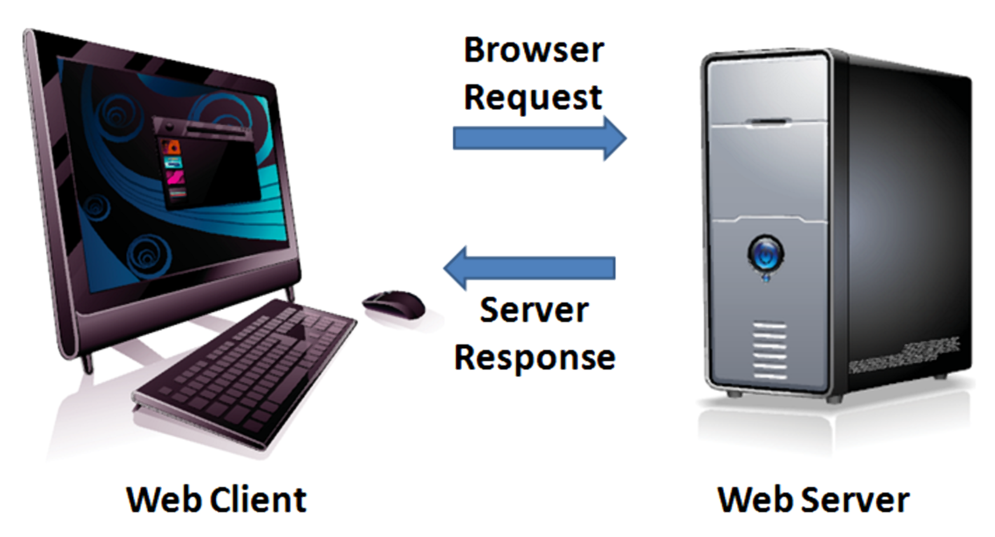
The Client/Server Model
The Internet
Client/Server Model
  Client: Web Browser
  Server: Web Server

Slide 9
Internet Protocols
Protocols
  Rules that describe the methods used for clients and servers to communicate with each other over a network.
There is no single protocol that makes the Internet and Web work.
A number of protocols with specific functions are needed.

Slide 10
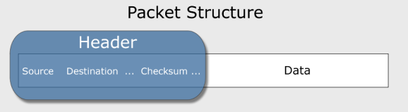
Common Internet Protocols
Official Communication Protocol: TCP/IP
Specialized Protocols:
  File Transfer: FTP
  E-mail: SMTP, POP3, IMAP
  Websites: HTTP

Slide 11
HTTP
Hypertext Transfer Protocol
A set of rules for exchanging files such as text, graphic images, sound, video, and other multimedia files on the Web.
Web browsers send HTTP requests for web pages and their associated files.
Web servers send HTTP responses back to the web browsers.
HTTP Request
HTTP Response

Slide 12
IP Address
Each device connected to the Internet has a unique numeric IP address.
These addresses consist of a set of four groups of numbers, called octets.
74.125.73.106 will get you Google!
An IP address may correspond to a domain name.

Slide 13
Domain Name
Locates an organization or other entity on the Internet
Domain Name System
  Divides the Internet into logical groups and understandable names
  Associates unique computer IP Addresses with the text-based domain names you type into a web browser
    Browser: http://google.com
    IP Address: 74.125.73.106

Slide 14
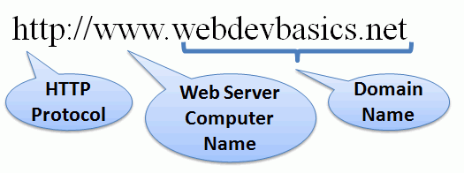
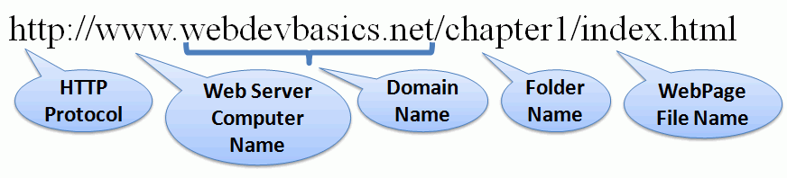
URI
Uniform Resource Indicator
URL
Uniform Resource Locator
Represents
the address
of a resource on the Internet.

Slide 15
TLD
Top-Level Domain Name
A top-level domain (TLD) identifies the right-most part of the domain name.
Some generic TLDs:
.com, .org, .net, .mil, .gov, .edu, .int, .aero, .asia, .cat, .jobs, .name, .biz, .museum, .info, .coop, .pro, .travel

Slide 16



Domain Name System
The Domain Name System (DNS) associates
Domain Names with IP addresses.
Domain Name
DNS
IP Address
Web Browser requests web page
Web
Server
Use TPC/IP
to send HTTP Request
Use TCP/IP
to send HTTP Responses
with web page files & images
Web Browser
displays web page
16

Slide 17
Markup Languages
SGML – Standard Generalized Markup Language
  A standard for specifying a markup language or tag set
HTML – Hypertext Markup Language
  The set of markup symbols or codes placed in a file intended for display on a web browser.
    Element or tag – individual markup code
    Attribute – modifies the purpose of a tag

Slide 18
THANK YOU

